Slide 1
Reference Data Management Offering

Slide 2

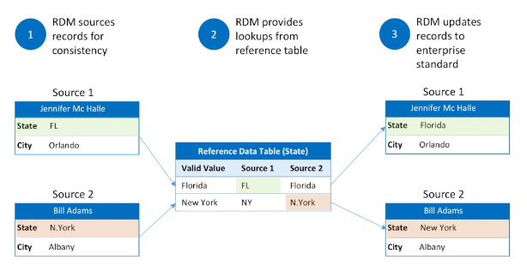



What is Reference Data Management?
Controlled vocabularies
Standardized sets of terms and definitions to ensure consistent use of language
Standardized codes
Standardized codes to categorize and organize data consistently
Taxonomies
Hierarchical classification systems to structure and relate data elements
Standardized data elements
Other types of reference data that support daily operations, analytics, and compliance
Reference data management ensures that the core building blocks of an organization's data ecosystem are accurate, consistent, and well-maintained, supporting daily operations, analytics, and regulatory compliance.

Slide 3




The Value of Reference Data Management
Supports Operational Efficiency
Enhances Decision-Making
Facilitates Collaboration
Ensures Regulatory Compliance
Consistent reference data ensures reliable data for daily business processes, reducing errors and improving productivity.
Accurate and trustworthy reference data enables better-informed strategic decisions and data-driven insights.
A centralized repository of reference data promotes seamless data sharing and integration across departments.
Standardized reference data helps organizations meet industry-specific compliance requirements and maintain data traceability.
By maintaining the integrity and reliability of an organization's core data assets, reference data management enables better decision-making, improved operational efficiency, and stronger regulatory compliance, ultimately supporting the overall success of the enterprise.

Slide 4
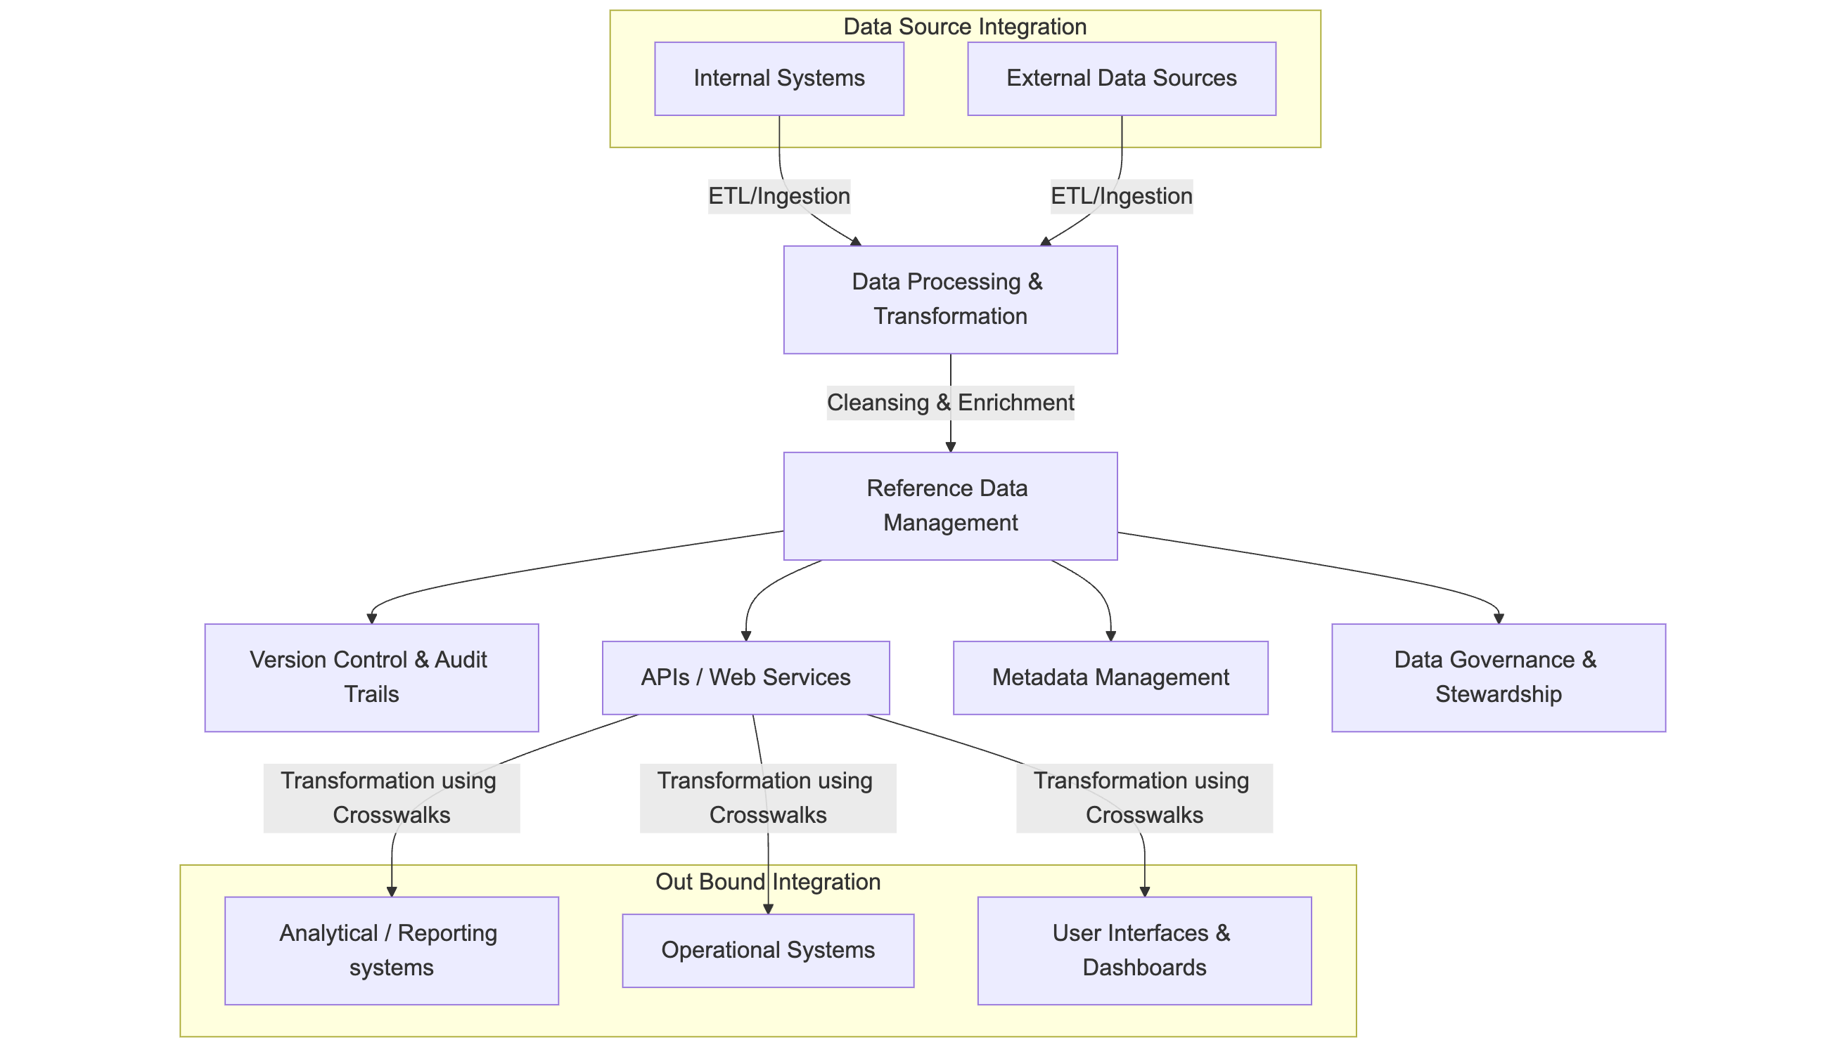
RDM Solution Architecture - Representative

Slide 5
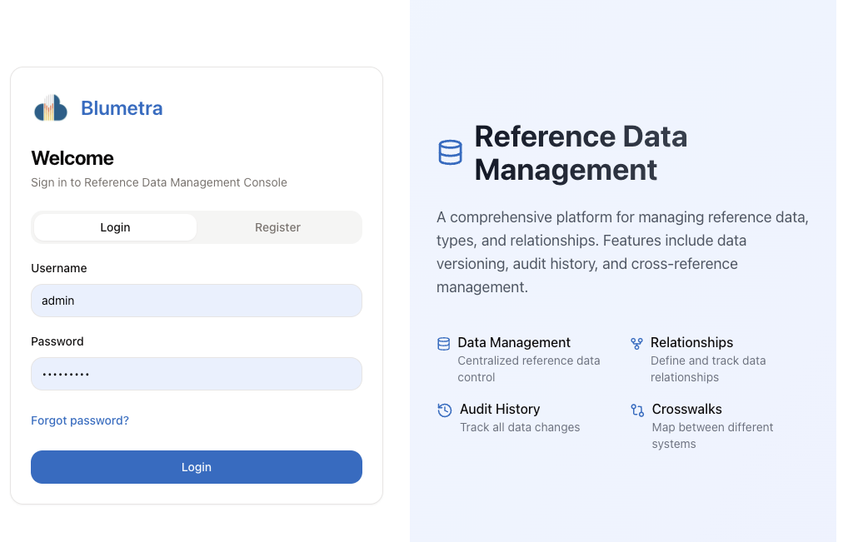
Blumetra’s RDM Solution - DEMO

